Slide 1

Chapter 4
Greedy Algorithms
Divesh Aggarwal
School of Computing
Department of Computer Science

Slide 2
Announcements: Midterm
The midterm is open book/notes. Electronic devices are not allowed.
The midterm will be based on lectures 1 to 4.
You are allowed to use any statement showed in the lecture or the assignments without proof. For any other proof you have read, you must write it.
If you are asked to write an algorithm, you should begin your solution by clearly writing recurrence relations (if there is any) and then clearly explaining your algorithm in words, and only then write the pseudocode if necessary.
Filling up pages will not help. Only write what is needed.
The exam is of 3 hours, and there will be 3-4 questions.

Slide 3
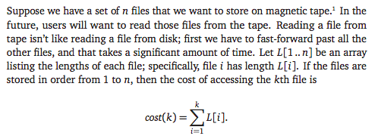
Storing files on a tape

Slide 4
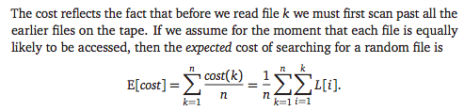

Storing files on a tape

Slide 5
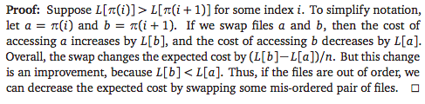
Storing files on a tape
This immediately leads to an O(n log n) time algorithm for the problem

Slide 6
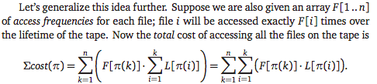
Storing files on a tape
We already proved that if all the frequencies are equal, we should sort the files by increasing size. If the frequencies are all different but the file lengths L[i] are all equal, then intuitively, we should sort the files by decreasing access frequency, with the most-accessed file first. Why?
What happens for varying file lengths and frequencies?

Slide 7

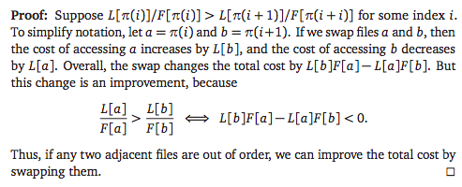
Storing files on a tape

Slide 8
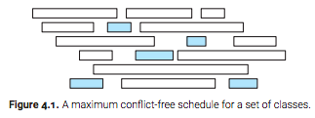
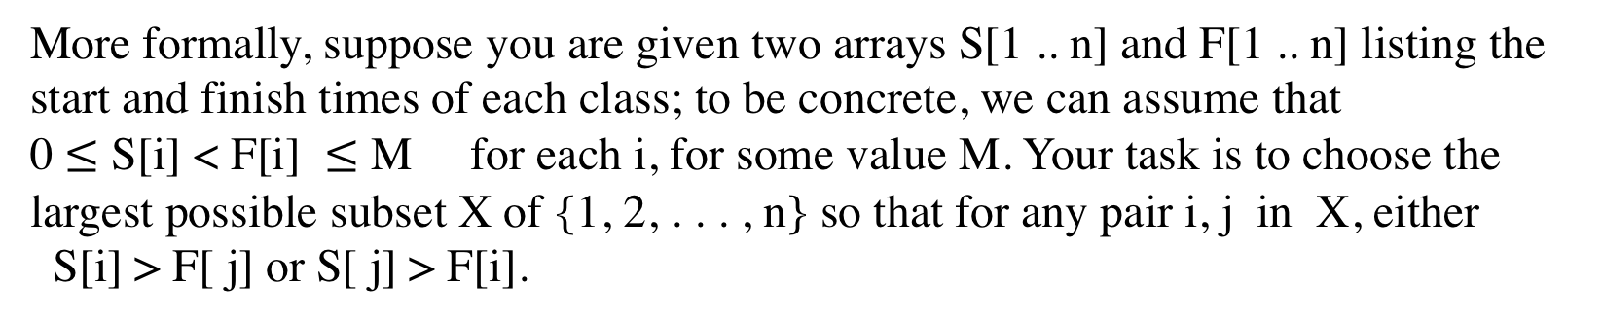
Scheduling classes
Suppose you wish to sign up for as many classes as possible without any overlap!
More formally, suppose you are given two arrays S[1 .. n] and F[1 .. n] listing the start and finish times of each class; to be concrete, we can assume that
0 $≤$ S[i] < F[i]  $≤$ M for each i, for some value M. Your task is to choose the largest possible subset X of {1, 2, . . . , n} so that for any pair i, j in X, either
S[i] > F[ j] or S[ j] > F[i].

Slide 9
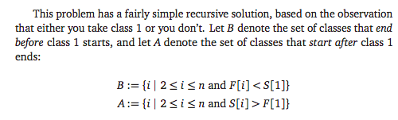
Scheduling classes
Evaluating this recursive algorithm from the bottom up gives us a dynamic programming algorithm that runs in O(n²) time. We don’t discuss the details because we can come up with a better algorithm for this problem.

Slide 10
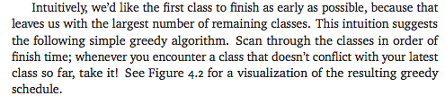
Scheduling classes

Slide 11
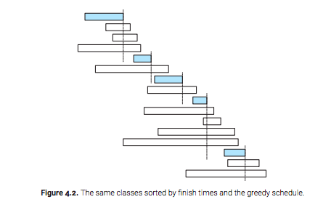
Scheduling classes

Slide 12
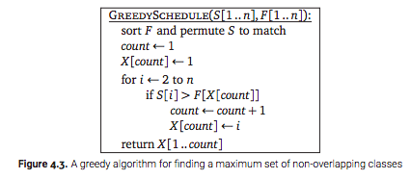
Scheduling classes

Slide 13
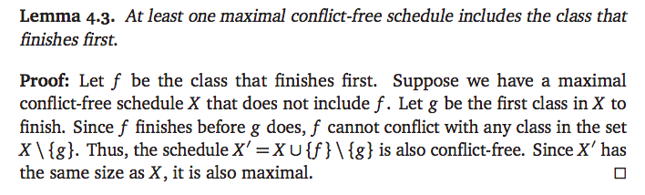
Scheduling classes
The correctness of the algorithm follows by induction.

Slide 14
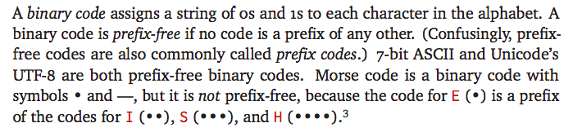
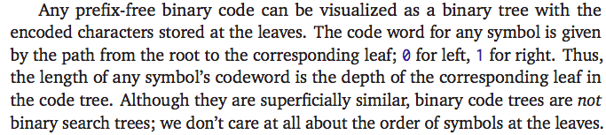
Huffman Codes

Slide 15
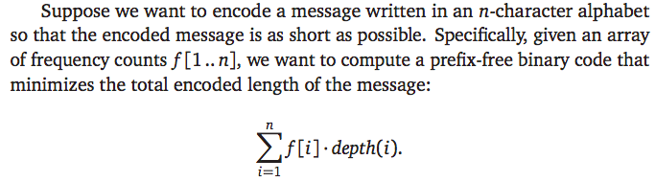

Huffman Codes

Slide 16
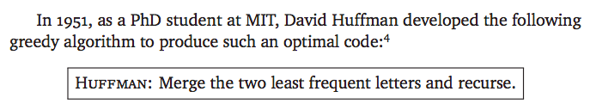
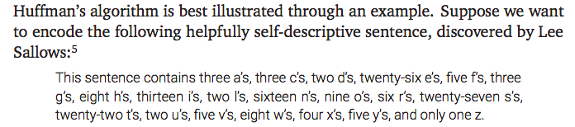
Huffman Codes

Slide 17

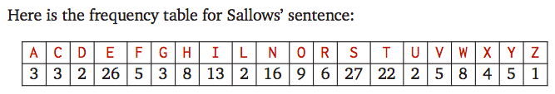
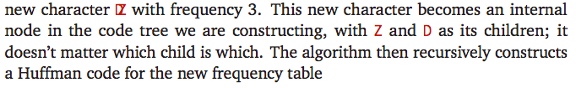
Huffman Codes

Slide 18
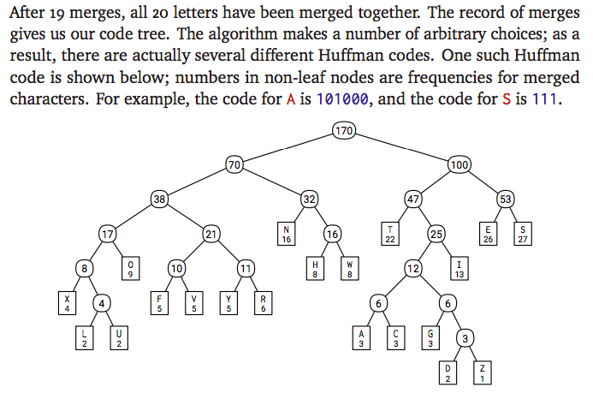
Huffman Codes

Slide 19
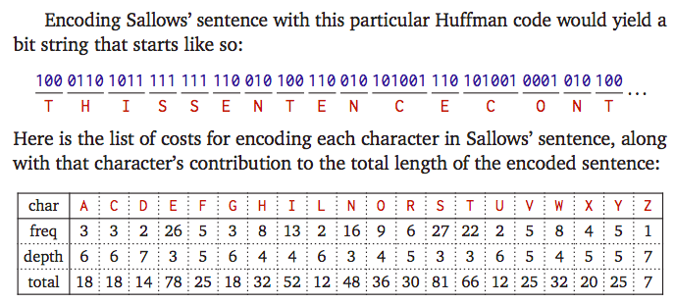
Huffman Codes

Slide 20

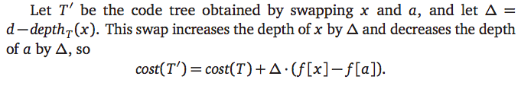
Correctness Proof
Let T be an optimal code tree, and suppose this tree has depth d. Because T is a full binary tree, it has at least two leaves at depth d that are siblings.
It follows that $cost\left(T^{′}\right)≤cost \left(T\right). Thus,cost\left(T^{′}\right)=cost \left(T\right).$

Slide 21
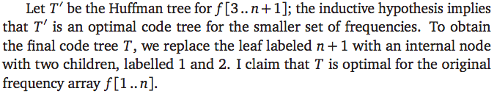
Optimality by induction
Let f [1 .. n] be the original input frequencies, and assume without loss of generality that f [1] and f [2] are the two smallest frequencies.
Define f [n + 1] = f [1] + f [2].

Slide 22
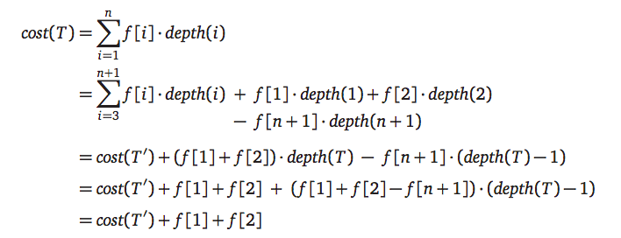
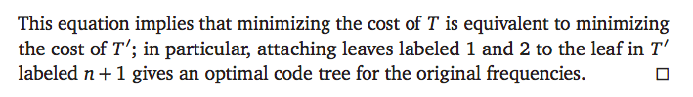
Optimality by induction

Slide 23
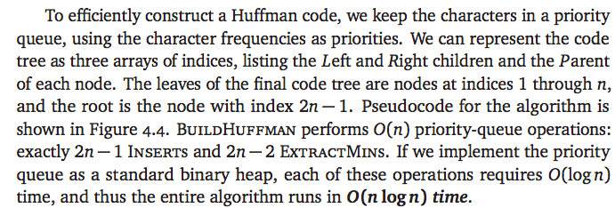
Implementation

Slide 24
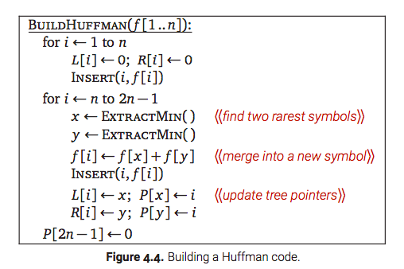
Implementation

